Slide 1
Problem Statement
Project Title: Power Manager Telemetry
In the era of 5G and edge computing, the deployment of devices across different locations has increased, leading to higher power consumption. To address this issue, the government is pushing enterprises and industries to reduce power usage. The goal is to achieve net-zero power consumption. Additionally, the price of electricity is increasing, making it crucial to understand the total power drawn by the system.
Researching and identifying open-source tools for power measurement.
Identifying and documenting the available knobs in a system to measure power.
Collect power telemetry data from CPU, memory, NIC, TDP, etc.
Measure and record system power utilization for CPU, NIC, and TDP based on the input parameter of system utilization percentage.
Create a report on the power problem, technical approach, and results.

Slide 2
Unique Idea Brief (Solution)
The Power Manager Telemetry project aims to develop a comprehensive solution for monitoring and analyzing system power utilization. By collecting telemetry data from various system components (CPU, Memory, NIC, TDP), the project provides insights into power consumption patterns, enabling optimizations and power-saving measures.
Solution Components:
Telemetry Data Collection
2. Load Simulation
3. Data Analysis and Reporting

Slide 3
Features Offered
1. Comprehensive Telemetry Data Collection
Real-time CPU usage statistics
Placeholder for TDP data
2. Dynamic Load Simulation
Customizable load generation using Docker containers
Python script for specified CPU utilization
3. Automated Data Logging
Continuous logging to a JSON file
Multi-threaded logging
4. Robust Data Analysis
Calculate average CPU, memory, and NIC utilization
Analyze all network interfaces
Handle missing or null data gracefully
5. Easy Integration and Customization
Modular code structure
Docker integration
6. User-Friendly Operation
Simple command-line interface (CLI)
Automated processes

Slide 4
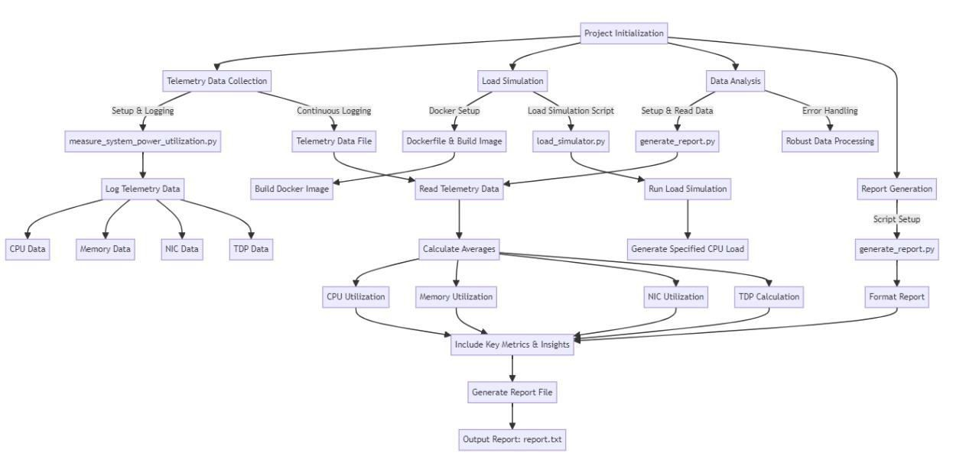
Process flow

Slide 5
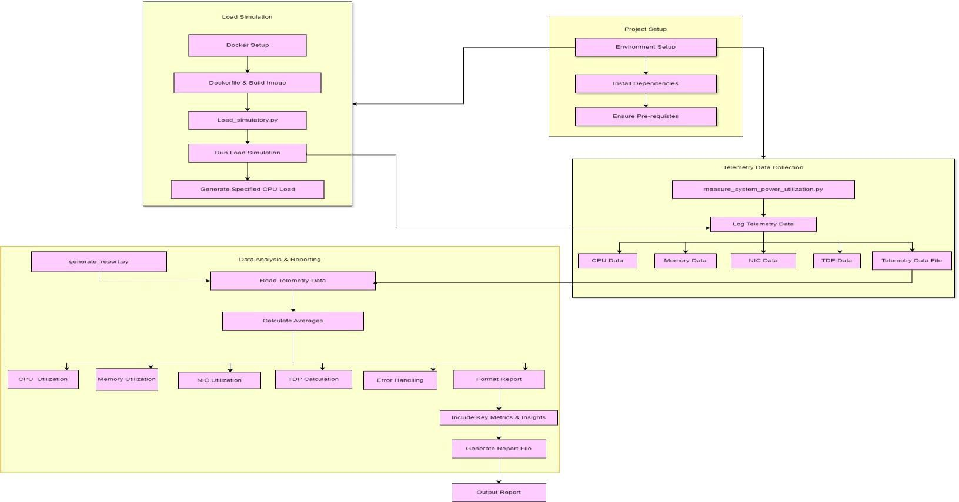
Architecture Diagram

Slide 6
Technologies used
Programming Languages:
  Python: Scripting for telemetry data collection, load simulation, and report generation. Libraries:
    psutil: Collect system telemetry data (CPU, memory, NIC).
    json: Read/write telemetry data.
    threading: Run parallel tasks (data logging).
    subprocess: Execute Docker commands.
Containerization:
  Docker:
    Create/manage containers for load simulation.
    Dockerfile: Define environment setup and dependencies.
    Docker CLI: Build images and run containers.
Data Analysis:
  CSV: Log telemetry data, enabling easy reading and writing of structured data.
Operating Systems:.
  Windows: Supported with adjustments (e.g., using Docker Desktop).
Documentation:
  Markdown: Write README files and documentation.

Slide 7
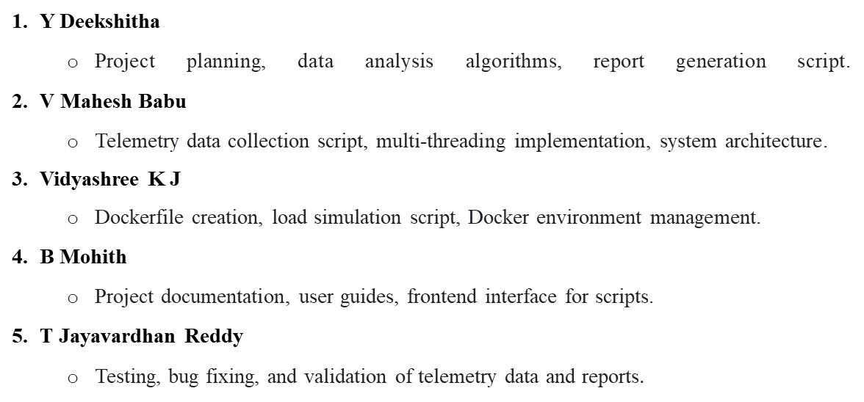
Team members and contributions:

Slide 8
Conclusion
The Power Manager Telemetry project represents a significant step forward in addressing the challenges of power consumption in modern computing environments, particularly in the context of 5G and edge computing deployments. By leveraging a combination of Python scripting, Docker containerization, and robust data analysis techniques, this project provides a comprehensive solution for monitoring and optimizing system power utilization.
In conclusion, the Power Manager Telemetry project not only addresses a critical issue in modern computing but also provides a scalable and adaptable framework for ongoing research and development. Through detailed data collection, robust analysis, and insightful reporting, this project contributes to the broader goal of sustainable and efficient computing practices.

